Slide 1
Collaborative University Android App
Adeel Asghar
Palak Patel
Hala Ali
Tyler Gross
Notes:
Presenter: Adeel

Slide 2
Outline
Purpose
Assumptions and Constraints
Use Cases
Sequence Diagram
Data Flow Diagram
Class Diagram
Database Design
Notes:
Presenter: Adeel

Slide 3
Purpose
Create a guideline for designing system and architecture of software product
Track requirements in depth with requirements traceability matrix
Helps development team stay organized
Notes:
Presenter: Adeel

Slide 4
Assumptions and constraints
ASSUMPTIONS
Firebase API connectivity
CONSTRAINTS
MVVM Design Pattern
Dagger Dependency Injection Framework
Firebase Database Limit on storage and document reads
Android device with operating system of Android 5 or higher
Notes:
Presenter: Adeel

Slide 5
Use cases
Notes:
Presenter: Adeel

Slide 6
4.1.2 Use Case 2: User Login
Created by | Palak Patel
Date Created | 2/18/2020
Last Updated by | Palak Patel
Date of last revision | 2/24/2020
Actors | Application User
Description | This use case will describe a user logging into the application.
Trigger | The user wants to login to their account, so they click the login button.
Preconditions | The user has not already logged, has an account and knows their credentials.
Post conditions | The user is now logged in and can access and see posts from any community.
Normal Flow | 1.The user enters their username and password. 2.The user selects the login button. 3.The user is redirected to the main forum page.
Alternative Flows | ALT FLOW 1: The login information cannot be found by Firebase Authentication. 1.The user enters invalid information 2.The use is prompted with an error message, returns to UC-2.
Frequency of Use | Every time a user logs out of the application.
Assumptions | There is an active internet connection and Firebase Authentication is Available
Notes:
Presenter: Palak

Slide 7
4.1.5 Use Case 5: Create Post
Created by | Palak Patel
Date Created | 2/18/2020
Last Updated by | Palak Patel
Date of last revision | 2/24/2020
Actors | Application User
Description | This use case will describe a user creating a post.
Trigger | When the user wants to create a post, so they select the create post button.
Preconditions | The user is logged in and has navigated to the create post page.
Post conditions | The post will show up on the user's main forum page, their profile page as well as in the forum that they posted to. The post will also added in Firebase in specified forum.
Normal Flow | 1.The user navigates to the create post screen. 2.The user chooses the forum that the wish to create their post in. 3.The user enters the title of their post. 4.The user enters the content of their post. 5.The user selects the add post button.
Alternative Flows | N/A
Frequency of Use | Every time the user wishes to make a post.
Assumptions | There is an active internet connection and the firebase Realtime Database is available.
Notes:
Presenter: Palak

Slide 8
4.1.3 Use Case 3: Subscribe to a Class Forum
Created by | Palak Patel
Date Created | 2/18/2020
Last Updated by | Palak Patel
Date of last revision | 2/24/2020
Actors | Application User
Description | This use case will describe a user subscribing to a class forum, so they select the subscribe button.
Trigger | When the user wants to subscribe to a specific forum.
Preconditions | The user is logged in and not already subscribed to the forum.
Post conditions | The posts from the forum that the user subscribed to will now show on their main forum page. The subscription will also added in Firebase subscription list for user.
Normal Flow | 1.The user navigates to the all classes screen. 2.The user selects the subscribe button for their chosen class.
Alternative Flows | N/A
Frequency of Use | This will be used whenever a user would like to subscribe to a forum.
Assumptions | There is an active internet connection and the firebase Realtime Database is available.
Notes:
Presenter: Palak

Slide 9
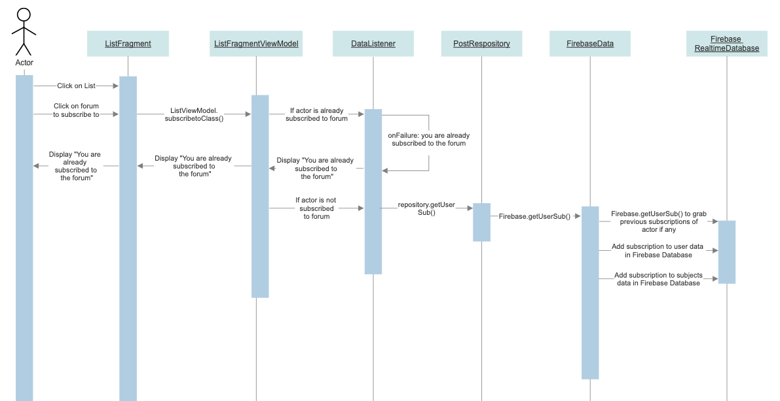
Sequence diagram
Notes:
Presenter: Hala

Slide 10
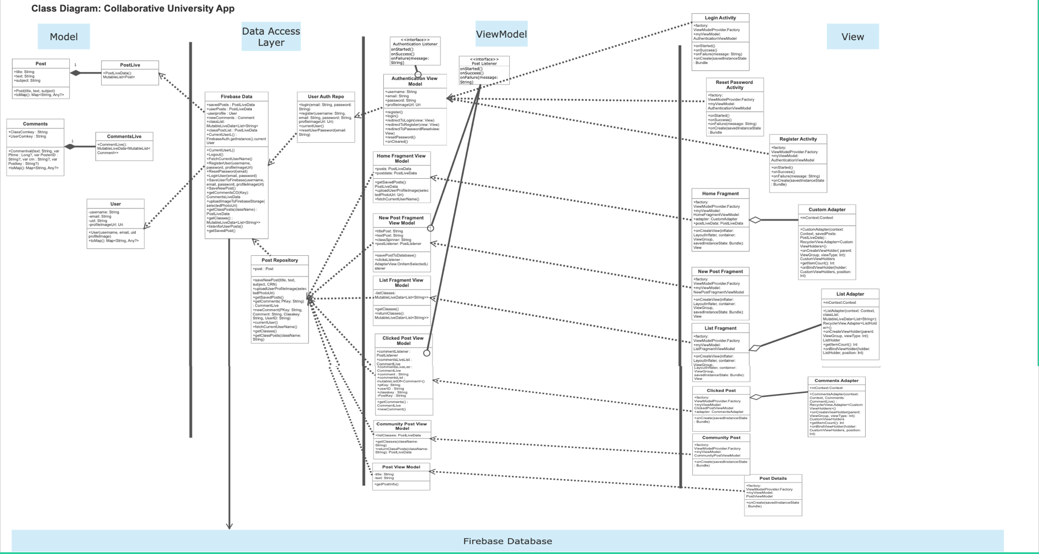
Class diagram
Notes:
Presenter: Hala

Slide 11
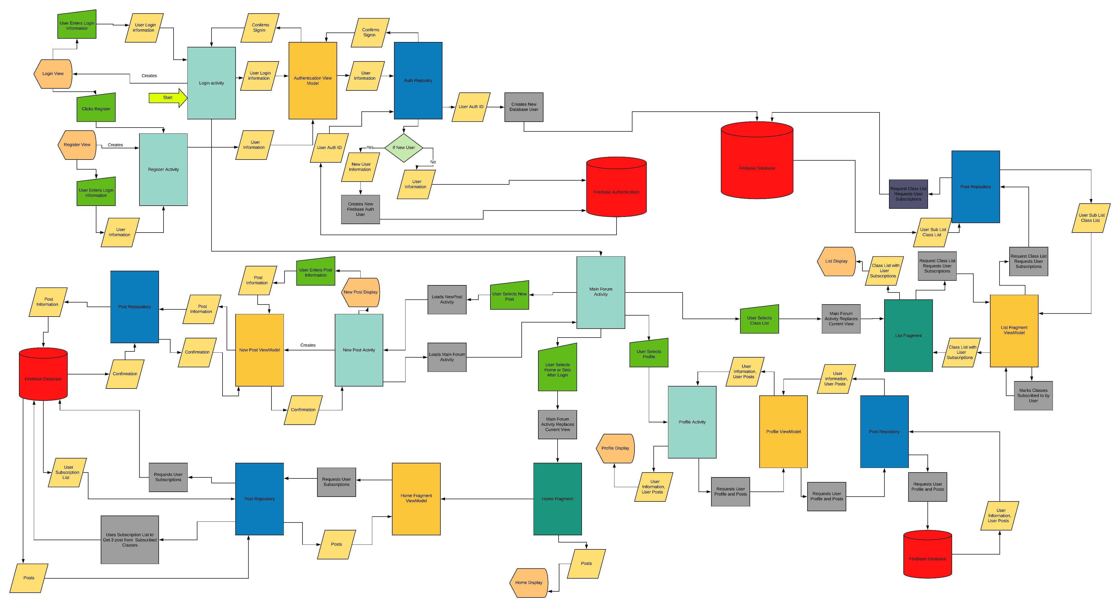
Dataflow diagram
Notes:
Presenter: Tyler

Slide 12
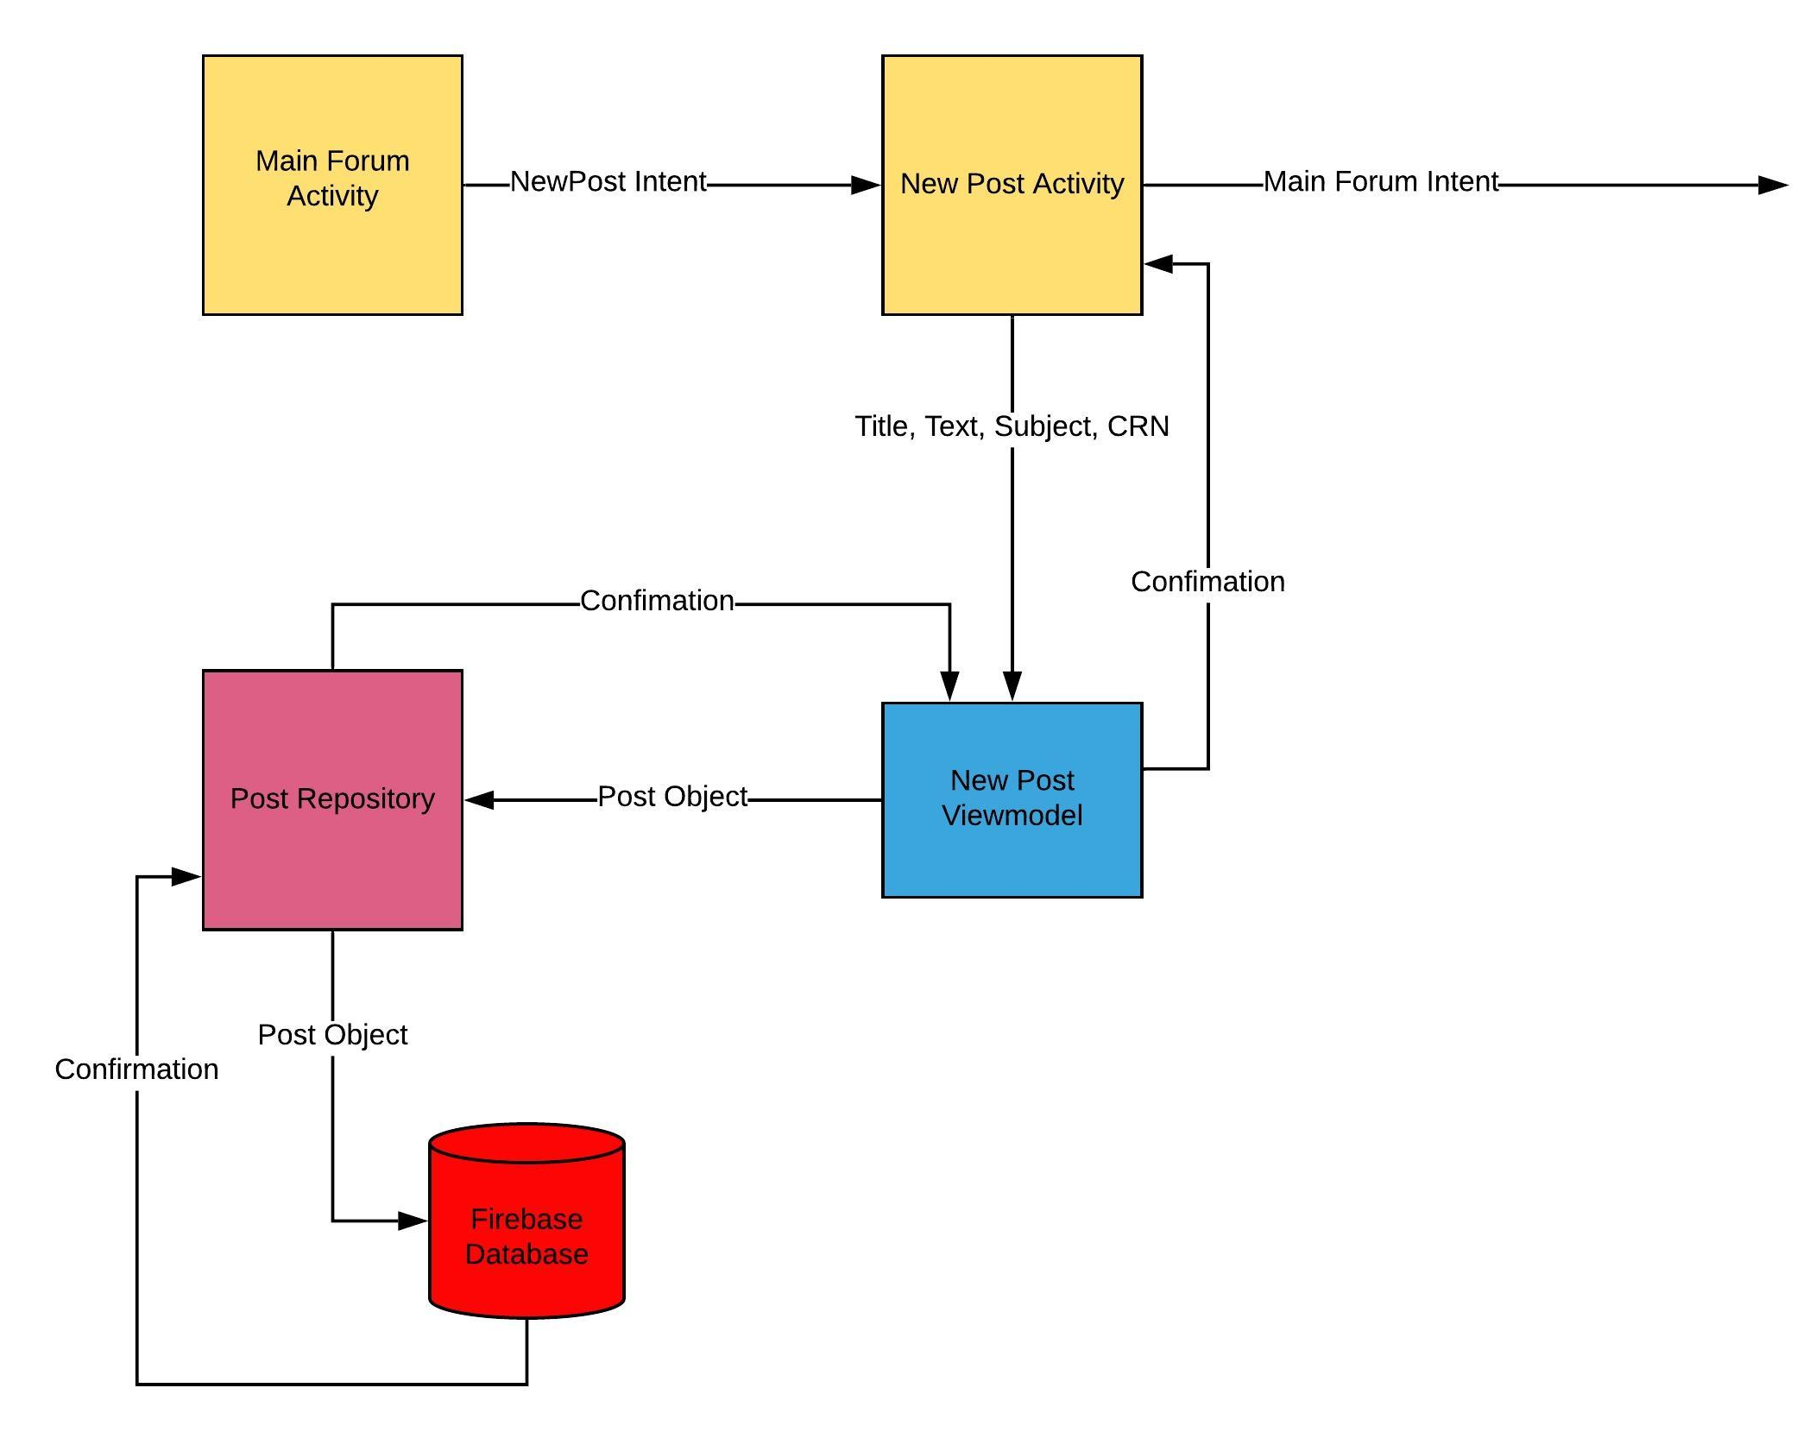
Dataflow diagram
Notes:
Presenter: Tyler

Slide 13
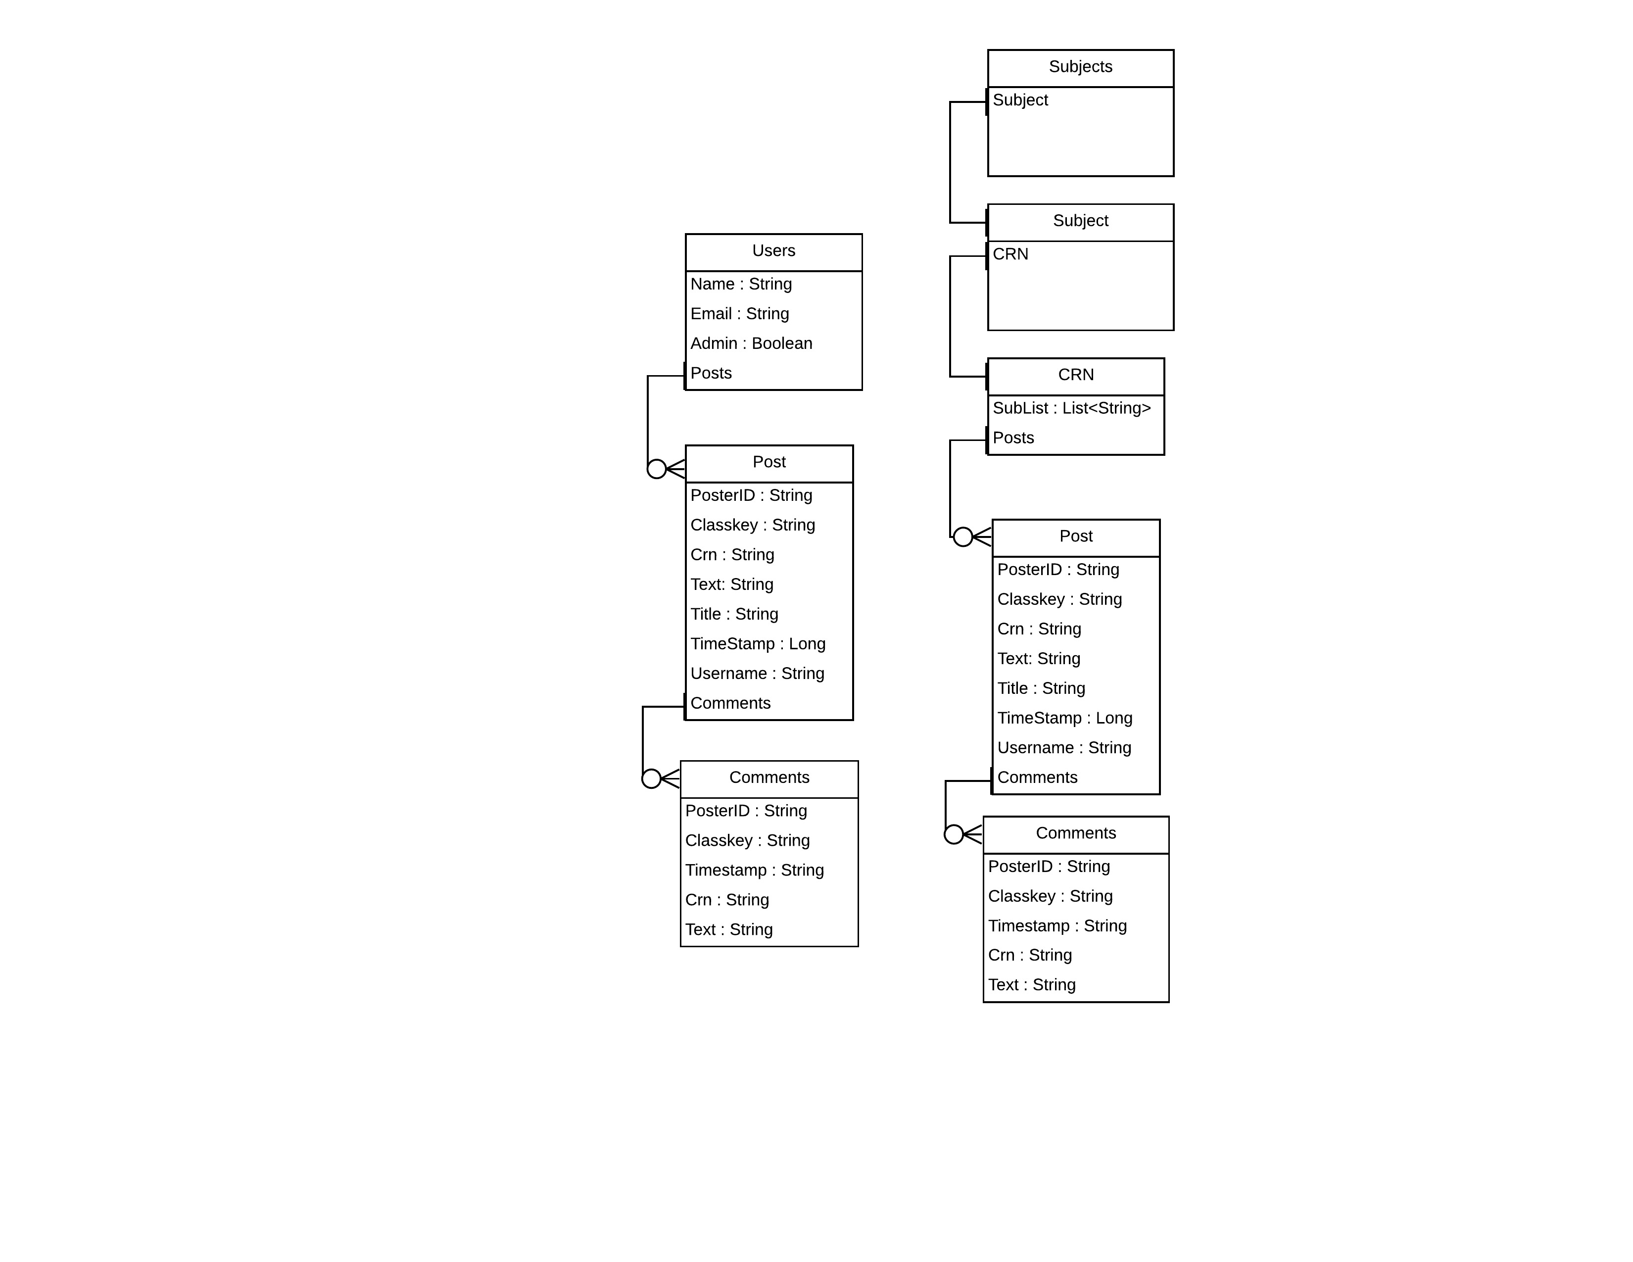
Database design
Notes:
Presenter: Tyler

Slide 14
Questions?
Notes:
Presenter: Tyler

